Slide 1


Structuring an extended thesis and using BRAVEN
Lecture 4

Slide 2

Aims of this session
To understand how to structure an extended thesis
To understand how to critique literature using BRAVEN

Slide 3

Academic writing
Academic writing conforms to a set of general moves.
“Academics say they enjoy innovative structures devised by their students, but they also warm very positively to the classic model” (Barnes, 1995 p.130)

Slide 4

The classic thesis is organised into sections:
Title page (not counted)
Contents page (not counted)
Abstract (not counted)
Introduction
Background Literature
Research Questions/Objectives
Main argument
Summary & conclusion
Recommendations
Reference List (not counted)
Bibliography (not counted)
Appendices (not counted)

Slide 5

Structural Moves
Within most sections of the project report there are a series of moves (Swales, 2000).

Slide 6
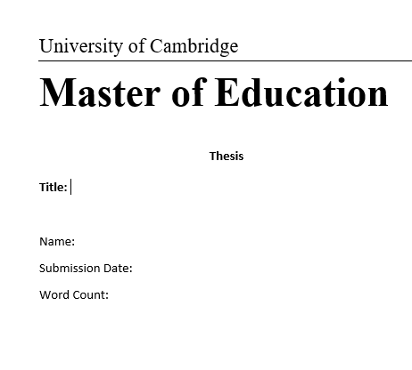
Title Page (cover)

Slide 7
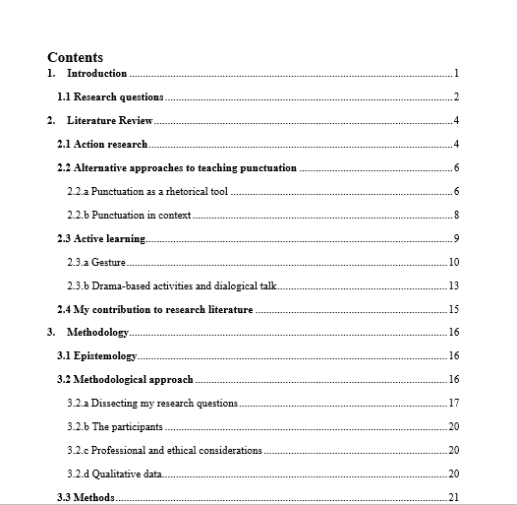
Contents Page
New skill tip: There are tools on Microsoft Word that will automatically assign page number to sections

Slide 8
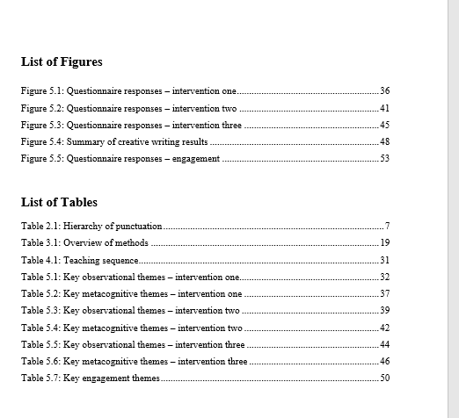
List of figures/tables (optional)

Slide 9


Abstract
Write this at the very end of your project!
This should summarise your main argument and findings.

Slide 10
Introduction (including rationale for your investigation) c.400-500 words
To clarify any key terms/ abbreviations
To establish the importance of the research
To explain the value (personally/wider scale)
To identify the gap
To provide the reader with a clear structure

Slide 11
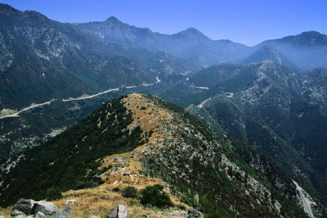
Structure of the Introduction
Establish the importance of the topic
Give a very brief synopsis of the topic
Explain your interest in the topic (rationale for researching this)
Outline approach
Define key terms/ abbreviations
Provide a synopsis of the research methods (if appropriate)
Structure
Provide an overview of how you will organise your report
Give your question

Slide 12
Background Literature c.400-500 words
To give the reader all the information they need to understand your research
To contextualise your research and emerging argument
***Only include information that is relevant to the argument that will follow. Use this to determine your research questions***

Slide 13
Research Questions/Objectives c.100 words
Clearly show your 3-6 research questions (or objectives) that will enable you to answer your overall question.
Aim: Was the 1982 Israeli invasion of Lebanon a success for Israel?
Definition of success: If the invasion achieved its military and economic aims, it would be considered a success.
RQ1: What was the military aim of the invasion?
RQ2: Was the military aim achieved?
RQ3: What was the economic aim?
RQ4: Was the economic aim achieved?
Conclusion: Balanced short-term and long-term success.

Slide 14
Main Argument c.3500 words
Functions
To answer your research questions/achieve your objectives
To demonstrate the depth and breadth of your reading
To establish connections between your study and previous studies
To point out that you know the arguments for and against the subject matter
To inspire, educate and excite the reader

Slide 15

Main argument structure will vary
Distant-close
You cite and discuss work ever closer to your own
Research question grouped
From distance to close under each research question
Chronological
History of research- be careful not to get too descriptive here.

Slide 16
Balance your arguments
Studies against
Books
Journals
Studies for
Gov. Reports
Books
journals
Research Question 1

Slide 17
Taxonomy of skills (Bloom, 1964)
Evaluation
Synthesis
Summary

Slide 18
Types of resources
Scholarly books
Journal articles
Conference abstracts

Slide 19
Types of resources
Gov. reports
Reliable newspapers
Jstor articles
My argument

Slide 20
Conclusion & recommendations c.500 words
Reiterate aims/ research question(s)
Restate key findings
Refrain from introducing new ideas
Recommend
Make a Difference
What should people do as a result of your research?

Slide 21
Reference List/ Bibliography
Citethisforme.com
There are referencing tools on Word

Slide 22

Appendices
Copy of questionnaire
Interview transcripts
Pictures/ diagrams not essential
Observation records
Extracts/ images

Slide 23

Small things, big difference
Avoid all things that may confuse - abbreviations
Signpost-direct the reader
Reference details in text and in References
Spell out numbers ten and under
Capitalisation - learn the rules and apply them
British spelling - adjust spell check

Slide 24
Examiner’s comments -
Narrow range of literature (Lecture 2)
Lack of critical analysis
Poorly structured (Lecture 3)
Lack of references (Lecture 2)
Making unsupported claims

Slide 25
73.6% Of All Statistics Are Made Up (Suster, 2010)

Slide 26
Okay, that may not be true but … 86% of people are more likely to believe you in you use a statistic

Slide 27
Okay, that may not be true but … 86% of people are more likely to believe you in you use a statistic (Miss Beatty thinks, based on no evidence whatsoever, 2019)

Slide 28
Statistics, claims and facts
https://www.youtube.com/watch?v=sxYrzzy3cq8&vl=en
Simpson’s Paradox

Slide 29

Assessing Reliability
Using BRAVEN to select resources and critically evaluate research

Slide 30
BRAVEN Bias Reputation Ability to See Vested Interest Expertise Neutrality

Slide 31

Bias Vs Neutrality
Confirmation bias occurs when we selectively notice or focus on evidence which tends to support the things we already believe or want to be true while ignoring that evidence which would serve to disconfirm those beliefs or ideas.
Comment on examples that are bias and neutral in your log, essay and/or presentation
AVOID CONFIRMATION BIAS IN YOUR PROJECT

Slide 32

Reputation
Consider the status and character of the website/organisation/person?
Have they published other credible sources?
Are they renowned for distorting truths?

Slide 33


Ability to See
Have they conducted the research personally?
If so, how many cases/experiments/examples have they considered? (This may in the form of references or primary data collection)

Slide 34
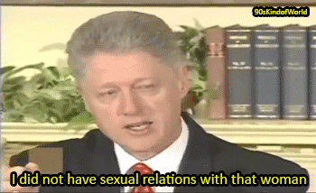
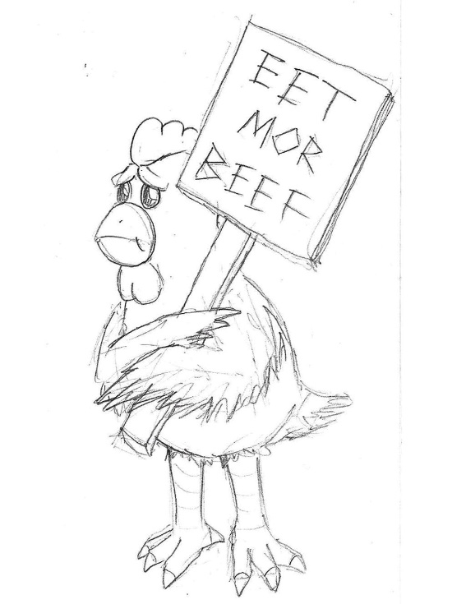
Vested Interest
What could they gain from passing on this information?
Have they got anything to lose?

Slide 35

Expertise
Have they got experience/qualifications/knowledge in this subject area?

Slide 36
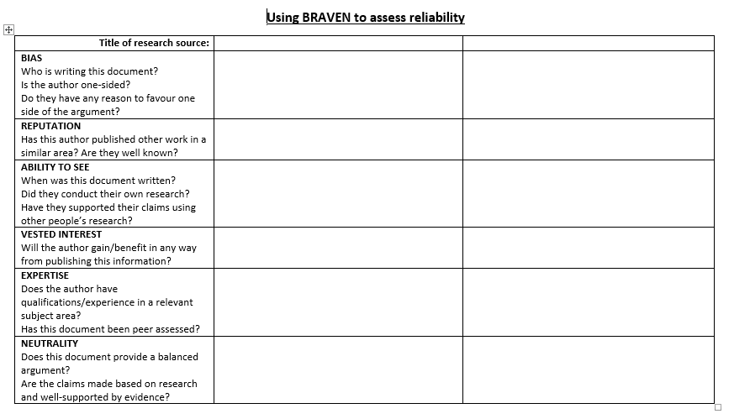
Evidence BRAVEN in your log, essay and presentation

Slide 37
Summary
Structure your thesis
Critically assess the reliability of sources
Any questions?

